Slide 1
Informed search algorithms
Chapter 4

Slide 2
Outline
Best-first search
Greedy best-first search
A* search
Heuristics
Local search algorithms
Hill-climbing search
Simulated annealing search
Local beam search
Genetic algorithms

Slide 3
Best-first search
Idea: use an evaluation function f(n) for each node
  f(n) provides an estimate for the total cost.
  Expand the node n with smallest f(n).
Implementation:
Order the nodes in fringe increasing order of cost.
Special cases:
  greedy best-first search
  A* search

Slide 4

Romania with straight-line dist.

Slide 5
Greedy best-first search
f(n) = estimate of cost from n to goal
e.g., f(n) = straight-line distance from n to Bucharest
Greedy best-first search expands the node that appears to be closest to goal.

Slide 6

Greedy best-first search example

Slide 7

Greedy best-first search example

Slide 8

Greedy best-first search example

Slide 9

Greedy best-first search example

Slide 10
Properties of greedy best-first search
Think of an example
Complete? No – can get stuck in loops.
Time? O(b^{m}), but a good heuristic can give dramatic improvement
Space? O(b^{m}) - keeps all nodes in memory
Optimal? No
e.g. Arad→Sibiu→Rimnicu Virea→Pitesti→Bucharest is shorter!

Slide 11
A* search
Idea: avoid expanding paths that are already expensive
Evaluation function f(n) = g(n) + h(n)
g(n) = cost so far to reach n
h(n) = estimated cost from n to goal
f(n) = estimated total cost of path through n to goal
Best First search has f(n)=h(n)
Uniform Cost search has f(n)=g(n)

Slide 12
Admissible heuristics
A heuristic h(n) is admissible if for every node n,
h(n) ≤ h*(n), where h*(n) is the true cost to reach the goal state from n.
An admissible heuristic never overestimates the cost to reach the goal, i.e., it is optimistic
Example: h_{SLD}(n) (never overestimates the actual road distance)
Theorem: If h(n) is admissible, A* using TREE-SEARCH is optimal

Slide 13

A* search example

Slide 14

A* search example

Slide 15

A* search example

Slide 16

A* search example

Slide 17

A* search example

Slide 18

A* search example

Slide 19
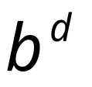
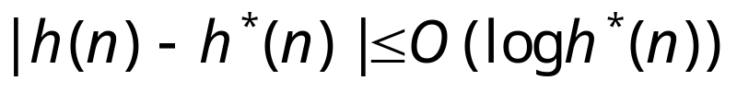
Properties of A*
Complete? Yes (unless there are infinitely many nodes with f ≤ f(G) , i.e. step-cost > ε)
Time/Space? Exponential
except if:
Optimal? Yes
Optimally Efficient: Yes (no algorithm with the
same heuristic is guaranteed to expand fewer nodes)

Slide 20

Optimality of A* (proof)
Suppose some suboptimal goal G₂ has been generated and is in the fringe. Let n be an unexpanded node in the fringe such that n is on a shortest path to an optimal goal G.
f(G₂) = g(G₂) since h(G₂) = 0
f(G) = g(G) since h(G) = 0
g(G₂) > g(G) since G₂ is suboptimal
f(G₂) > f(G) from above
h(n) ≤ h*(n) since h is admissible (under-estimate)
g(n) + h(n) ≤ g(n) + h*(n) from above
f(n) ≤ f(G) since g(n)+h(n)=f(n) & g(n)+h*(n)=f(G)
f(n) < f(G2) from
We want to prove:
f(n) < f(G2)
(then A* will prefer n over G2)

Slide 21

Consistent heuristics
A heuristic is consistent if for every node n, every successor n' of n generated by any action a,
h(n) ≤ c(n,a,n') + h(n')
If h is consistent, we have
f(n’) = g(n’) + h(n’) (by def.)
= g(n) + c(n,a,n') + h(n’) (g(n’)=g(n)+c(n.a.n’))
≥ g(n) + h(n) = f(n) (consistency)
f(n’) ≥ f(n)
i.e., f(n) is non-decreasing along any path.
Theorem:
If h(n) is consistent, A* using GRAPH-SEARCH is optimal
It’s the triangle
inequality !
keeps all checked nodes
in memory to avoid repeated
states

Slide 22

Optimality of A*
A* expands nodes in order of increasing f value
Gradually adds "f-contours" of nodes
Contour i contains all nodes with f≤f_{i} where f_{i} < f_{i+1}

Slide 23
straight-line distances
A
6
D
1
F
3
1
h(S-G)=10
h(A-G)=7
h(D-G)=1
h(F-G)=1
h(B-G)=10
h(E-G)=8
h(C-G)=20
S
2
4
8
G
B
E
1
20
C
try yourself
The graph above shows the step-costs for different paths going from the start (S) to
the goal (G). On the right you find the straight-line distances.
Draw the search tree for this problem. Avoid repeated states.
Give the order in which the tree is searched (e.g. S-C-B...-G) for A* search.
Use the straight-line dist. as a heuristic function, i.e. h=SLD,
and indicate for each node visited what the value for the evaluation function, f, is.

Slide 24
Memory Bounded Heuristic Search: Recursive BFS
How can we solve the memory problem for A* search?
Idea: Try something like depth first search, but let’s not forget everything about the branches we have partially explored.
We remember the best f-value we have found so far in the branch we are deleting.

Slide 25
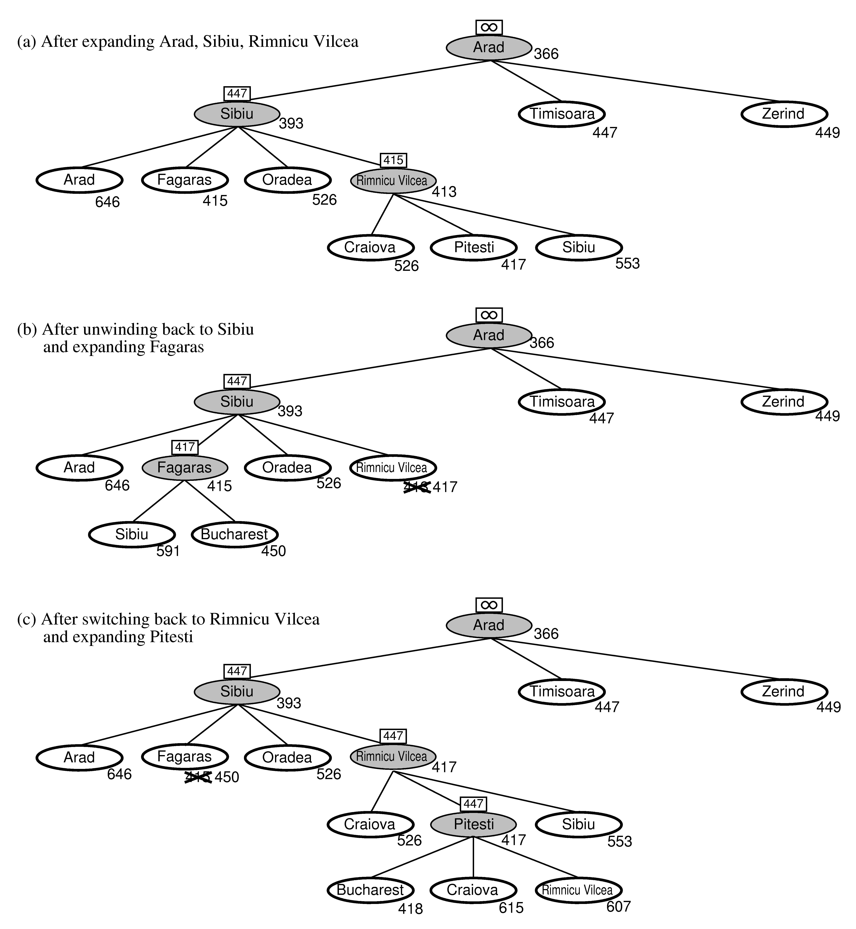
RBFS:
best alternative
over fringe nodes,
which are not children:
do I want to back up?
RBFS changes its mind
very often in practice.
This is because the
f=g+h become more
accurate (less optimistic)
as we approach the goal.
Hence, higher level nodes
have smaller f-values and
will be explored first.
Problem: We should keep
in memory whatever we can.

Slide 26
Simple Memory Bounded A*
This is like A*, but when memory is full we delete the worst node (largest f-value).
Like RBFS, we remember the best descendent in the branch we delete.
If there is a tie (equal f-values) we delete the oldest nodes first.
simple-MBA* finds the optimal reachable solution given the memory constraint.
Time can still be exponential.
A Solution is not reachable
if a single path from root to goal
does not fit into memory

Slide 27

Admissible heuristics
E.g., for the 8-puzzle:
h₁(n) = number of misplaced tiles
h₂(n) = total Manhattan distance
(i.e., no. of squares from desired location of each tile)
h₁(S) = ?
h₂(S) = ?

Slide 28
Admissible heuristics
E.g., for the 8-puzzle:
h₁(n) = number of misplaced tiles
h₂(n) = total Manhattan distance
(i.e., no. of squares from desired location of each tile)
h₁(S) = ? 8
h₂(S) = ? 3+1+2+2+2+3+3+2 = 18

Slide 29
Dominance
If h₂(n) ≥ h₁(n) for all n (both admissible)
then h₂ dominates h₁
h₂ is better for search: it is guaranteed to expand
less or equal nr of nodes.
Typical search costs (average number of nodes expanded):
d=12 IDS = 3,644,035 nodes
A*(h₁) = 227 nodes
A*(h₂) = 73 nodes
d=24 IDS = too many nodes
A*(h₁) = 39,135 nodes
A*(h₂) = 1,641 nodes

Slide 30
Relaxed problems
A problem with fewer restrictions on the actions is called a relaxed problem
The cost of an optimal solution to a relaxed problem is an admissible heuristic for the original problem
If the rules of the 8-puzzle are relaxed so that a tile can move anywhere, then h₁(n) gives the shortest solution
If the rules are relaxed so that a tile can move to any adjacent square, then h₂(n) gives the shortest solution

Slide 31
Local search algorithms
In many optimization problems, the path to the goal is irrelevant; the goal state itself is the solution
State space = set of "complete" configurations
Find configuration satisfying constraints, e.g., n-queens
In such cases, we can use local search algorithms
keep a single "current" state, try to improve it.
Very memory efficient (only remember current state)

Slide 32

Example: n-queens
Put n queens on an n × n board with no two queens on the same row, column, or diagonal
Note that a state cannot be an incomplete configuration with m<n queens

Slide 33

Hill-climbing search
Problem: depending on initial state, can get stuck in local maxima

Slide 34
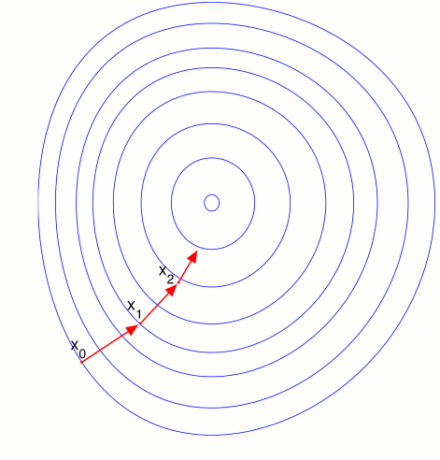

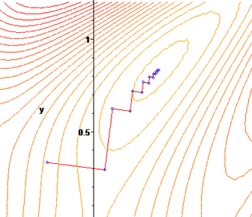
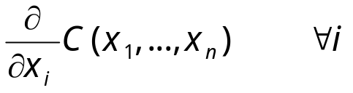
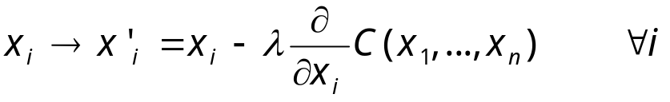
Gradient Descent
Assume we have some cost-function:
and we want minimize over continuous variables X1,X2,..,Xn
1. Compute the gradient :
2. Take a small step downhill in the direction of the gradient:
3. Check if
4. If true then accept move, if not reject.
5. Repeat.

Slide 35
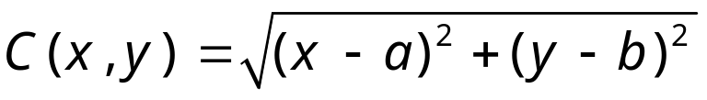
Exercise
Describe the gradient descent algorithm for the cost function:

Slide 36

Hill-climbing search: 8-queens problem
Each number indicates h if we move
a queen in its corresponding column
h = number of pairs of queens that are attacking each other, either directly or indirectly (h = 17 for the above state)

Slide 37

Hill-climbing search: 8-queens problem
A local minimum with h = 1
what can you do to get out of this local minima?)

Slide 38
Simulated annealing search
Idea: escape local maxima by allowing some "bad" moves but gradually decrease their frequency.
This is like smoothing the cost landscape.

Slide 39
Properties of simulated annealing search
One can prove: If T decreases slowly enough, then simulated annealing search will find a global optimum with probability approaching 1 (however, this may take VERY long)
Widely used in VLSI layout, airline scheduling, etc.

Slide 40
Local beam search
Keep track of k states rather than just one.
Start with k randomly generated states.
At each iteration, all the successors of all k states are generated.
If any one is a goal state, stop; else select the k best successors from the complete list and repeat.

Slide 41
Genetic algorithms
A successor state is generated by combining two parent states
Start with k randomly generated states (population)
A state is represented as a string over a finite alphabet (often a string of 0s and 1s)
Evaluation function (fitness function). Higher values for better states.
Produce the next generation of states by selection, crossover, and mutation

Slide 42


Fitness function: number of non-attacking pairs of queens (min = 0, max = 8 × 7/2 = 28)
P(child) = 24/(24+23+20+11) = 31%
P(child) = 23/(24+23+20+11) = 29% etc
fitness:
#non-attacking queens
probability of being
regenerated
in next generation

Slide 43
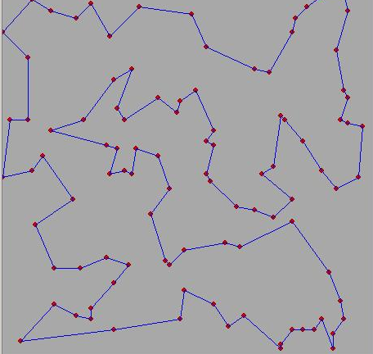
Exercise
Traveling salesman problem.
Given N cities and all their distances, find the shortest tour through all cities.
1. Define representation (genes)
2. Define cross-over (create valid paths)
3. Define mutation
4. Define fitness
5. How do we choose children?
DEMO:
http://www-cse.uta.edu/~cook/ai1/lectures/applets/gatsp/TSP.html

Slide 44
Project
Implement a genetic algorithm to solve the following problem:
Consider filling a MxN rectangle with the numbers 1...MN
Each number has either 4 neighbors or 3 neighbors
(on the edge) or 2 neighbors (in a corner).
The total cost is the of all the absolute differences
between all neighboring pairs of numbers.
We’ll give you a big problem after some deadline and you then
have a couple of days to find the best solution you can find.
The lowest cost solution wins.
If you come up with a fancy alternative to GA you may request
to implement that as an alternative to solve the same problem.
1
2
3
4
5
6
7
8
9
10
11
12
cost = |1-2|+|2-3|+|3-4|+|5-6|+|6-7|+|7-8|+|9-10|+|10-11|+|11-12|
+ |1-5|+|2-6|+|3-7|+|4-8|+|5-9|+|6-10|+|7-11|+|8-12|

Slide 45
Exercise
SEARCH TREE
R
9
1
1) Consider the search tree to the right.
There are 2 goal states, G1 and G2.
The numbers on the edges represent step-costs.
You also know the following heuristic estimates:
h(B→G2) = 9, h(D→G2)=10, h(A→G1)=2, h(C→G1)=1
a) In what order will A* search visit the
nodes? Explain your answer by indicating the value of
the evaluation function for those nodes that the
algorithm considers.
A
B
1
2
C
D
1
10
G1
G2

Slide 46
straight-line distances
A
6
D
1
F
3
1
h(S-G)=10
h(A-G)=7
h(D-G)=1
h(F-G)=1
h(B-G)=10
h(E-G)=8
h(C-G)=20
S
2
4
8
G
B
E
1
20
C
The graph above shows the step-costs for different paths going from the start (S) to
the goal (G). On the right you find the straight-line distances.
Draw the search tree for this problem. Avoid repeated states.
Give the order in which the tree is searched (e.g. S-C-B...-G) for the following
search algorithms: a) Breadth-first search, Depth first search, uniform cost search,
and A* search. For A* use the straight-line dist. as a heuristic function, i.e. h=SLD,
and indicate for each node visited what the value for the evaluation function, f, is.
For each algorithm indicate whether it is an informed or an uninformed search
strategy.
For each algorithm indicate separately whether its time complexity is polynomial
or exponential in the number of nodes visited. Same for space complexity.
For each algorithm indicate separately whether it is complete and/or optimal.
Answer these questions for generic search problems. Assume step-cost positive but not constant,
do not assume we can avoid repeated states, do not assume we have a very good heuristic
function h.

Slide 47
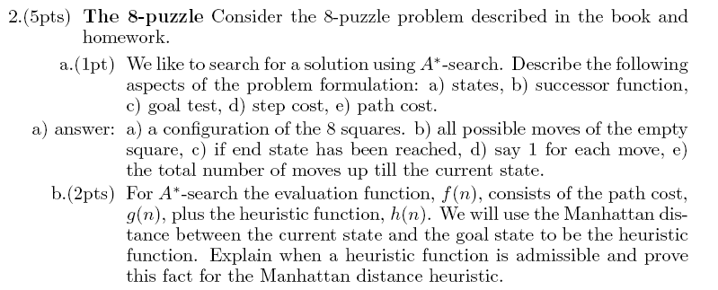


Slide 48
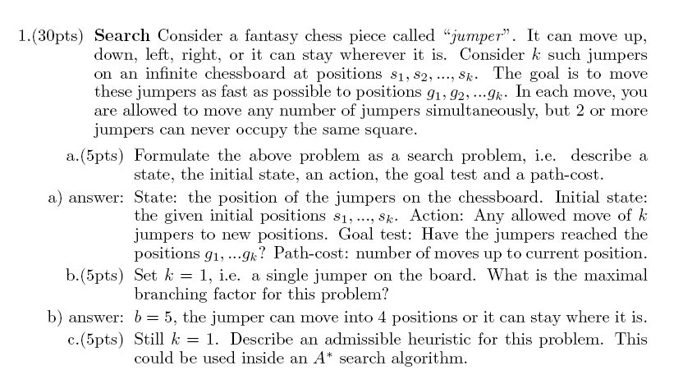
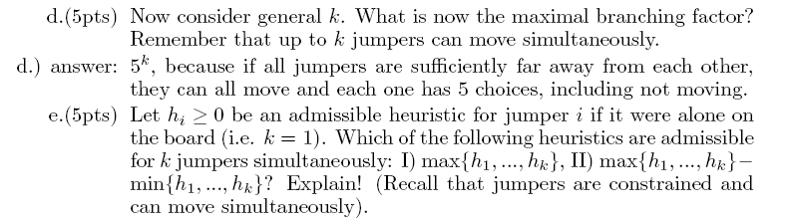


Slide 49
Appendix
Some details of the MBA* next.

Slide 50
SMA* pseudocode (not in 2nd edition 2 of book)
function SMA*(problem) returns a solution sequence
inputs: problem, a problem
static: Queue, a queue of nodes ordered by f-cost
Queue ← MAKE-QUEUE({MAKE-NODE(INITIAL-STATE[problem])})
loop do
if Queue is empty then return failure
n ← deepest least-f-cost node in Queue
if GOAL-TEST(n) then return success
s ← NEXT-SUCCESSOR(n)
if s is not a goal and is at maximum depth then
f(s) ← ∞
else
f(s) ← MAX(f(n),g(s)+h(s))
if all of n’s successors have been generated then
update n’s f-cost and those of its ancestors if necessary
if SUCCESSORS(n) all in memory then remove n from Queue
if memory is full then
delete shallowest, highest-f-cost node in Queue
remove it from its parent’s successor list
insert its parent on Queue if necessary
insert s in Queue
end

Slide 51
Simple Memory-bounded A* (SMA*)
(Example with 3-node memory)
maximal depth is 3, since
memory limit is 3. This
branch is now useless.
Progress of SMA*. Each node is labeled with its current f-cost. Values in parentheses show the value of the best forgotten descendant.
best forgotten node
Search space
best estimated solution
so far for that node
f = g+h
= goal
A
A
13[15]
0+12=12
A
A
A
10
8
12
12
13
B
G
G
10+5=15
8+5=13
13
10
10
8
16
15
B
B
G
15
13
18
H
C
D
H
I
∞
20+5=25
16+2=18
20+0=20
24+0=24
A
A
A
10
10
8
8
15[15]
15[24]
20[24]
E
F
J
K
A
8
30+5=35
30+0=30
24+0=24
24+5=29
15
B
B
G
15
20[∞]
24[∞]
B
G
I
15
24
C
25
D
24
∞
20
Algorithm can tell you when best solution found within memory constraint is optimal or not.

